Slide 1
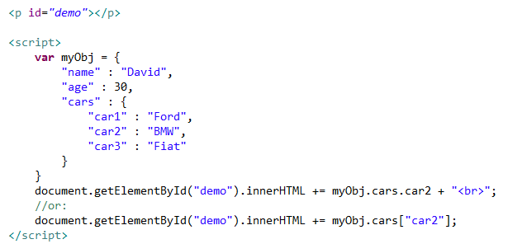
Nested JSON Objects
Values in a JSON object can be another JSON object.

